Slide 1
Figma Tutorial
Tu Lam

Slide 2

What is Figma?
A web-based graphics editing and user interface design app.
Use it to do all kinds of graphic design work from wireframing websites, designing mobile app interfaces, prototyping designs, etc…
Work with other on brainstorming, designing, and building a prototype together.
Image Credit: Figma.com

Slide 3
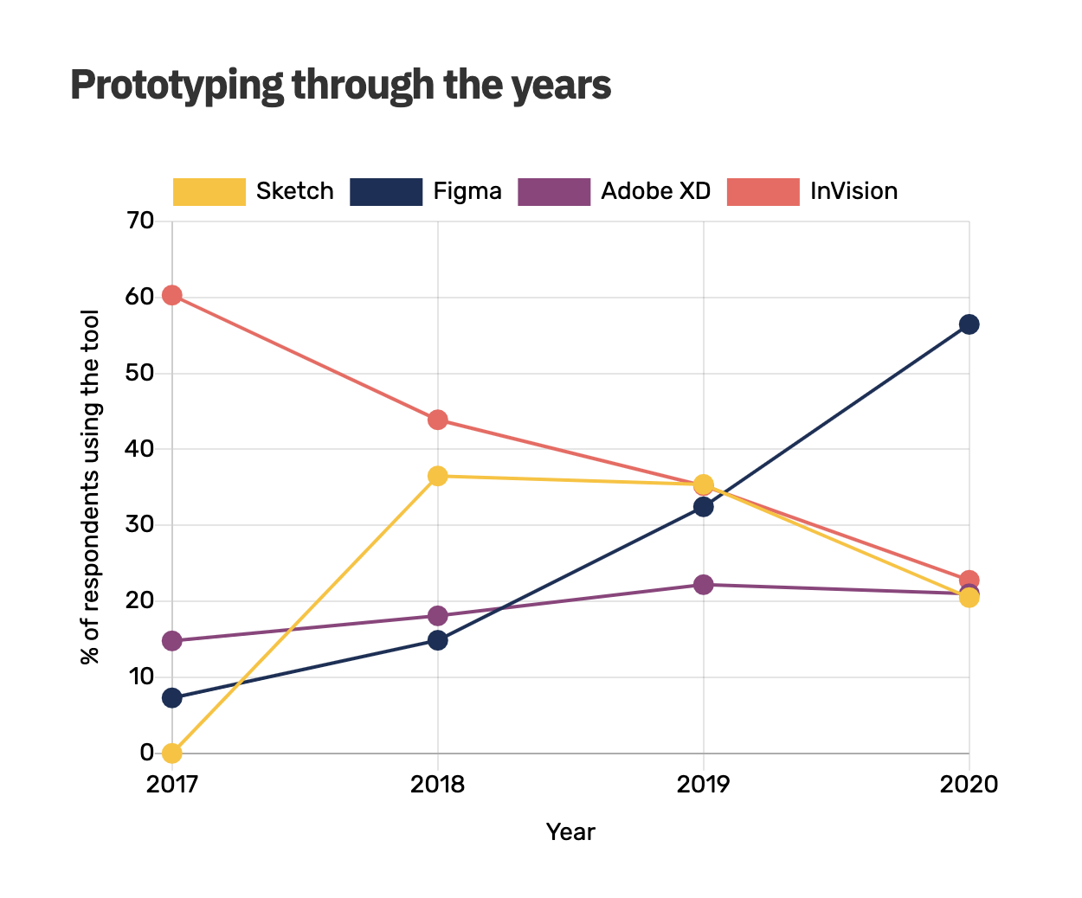
57%
People Usage of Figma in 2020
Figma has seen an explosion of growth and popularity, rising from about 8% of respondents using the tool in 2017 to about 57% in 2020.
Image Credit: https://uxdesign.cc/the-precipitous-rise-of-figma-and-fall-of-invision-435f07e8d1b6

Slide 4
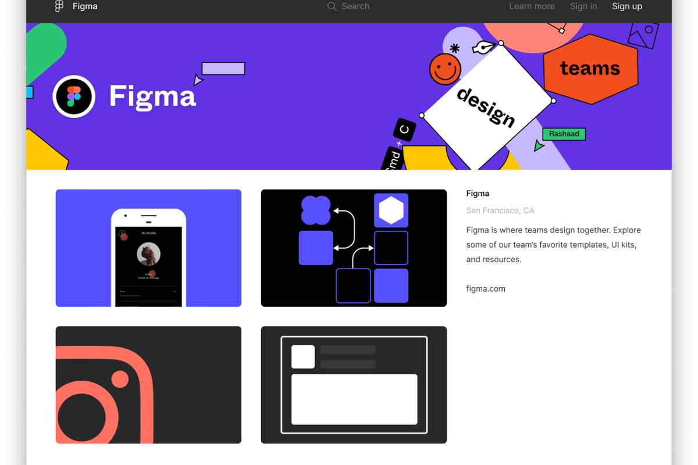
Why is it important to use?
A great way to quickly design, build, and export files for animation and prototyping.
Use it to create a mock-up visual prototype for your team project to see how it would look and operate.
Be able to work together with other synchronously or asynchronously.
Image Credit: The Verge

Slide 5
Demo of Figma!

Slide 6
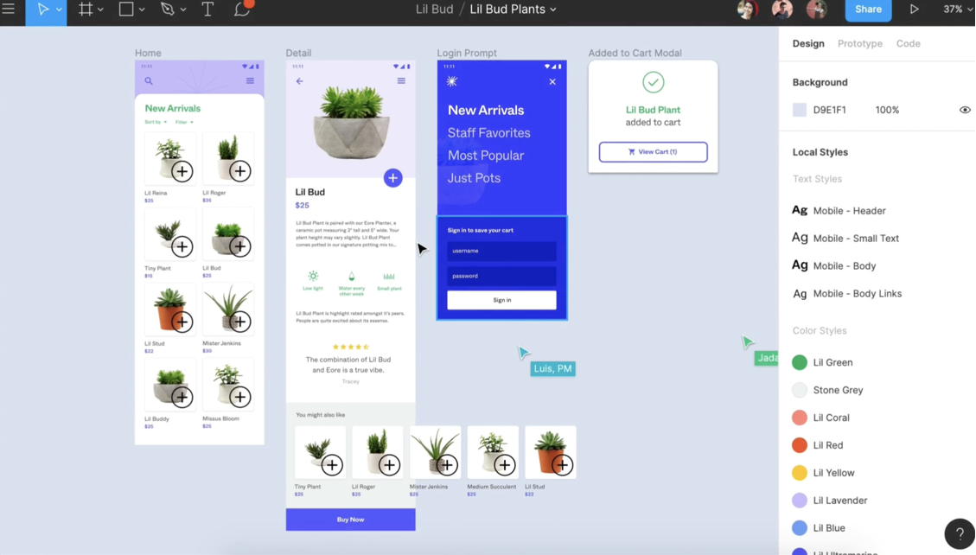
Figma Recap
A good mockup tool to use to build a prototype for project.
Collab together to brainstorm, design, and build.
A good way to see a representation of how a project is going to look and interact.
Image Credit: Figma.com
Image Credit: UX Planet

Slide 7
The End
Feel free to ask if you have any questions!

